Slide 1


Project Phase –II (18EEP83)
Progress I
PRESENTATION ON
WIRELESS CHARGING SYSTEM FOR ELECTRIC VEHICLES
by
Harshitha L 4GW19EE014
Nisarga B 4GW19EE022
Nisarga M 4GW19EE023
Sahana R K 4GW19EE034
Under the Guidance of
Dr. Jagadisha N
Associate Professor
Dept. of EEE, GSSSIETW, Mysuru
Department of Electrical & Electronics Engineering

Slide 2
SUMMARY OF PHASE-1
In phase-1 progress 1&2 we discussed about reason for taking up this project
Literature survey
Objectives
Scope of the project
Methodology
Block diagram
Components used
References

Slide 3
Hardware Implementation
Hardware Implementation consists of two circuits
Main circuit: It consists of Transmitter, Receiver, Battery system
Control circuit: It consists of Arduino Uno, RFID reader, Relay unit, Bluetooth module

Slide 4
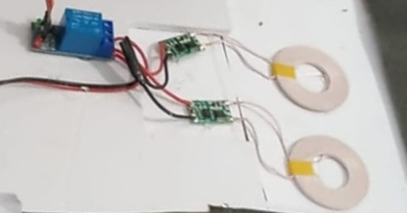
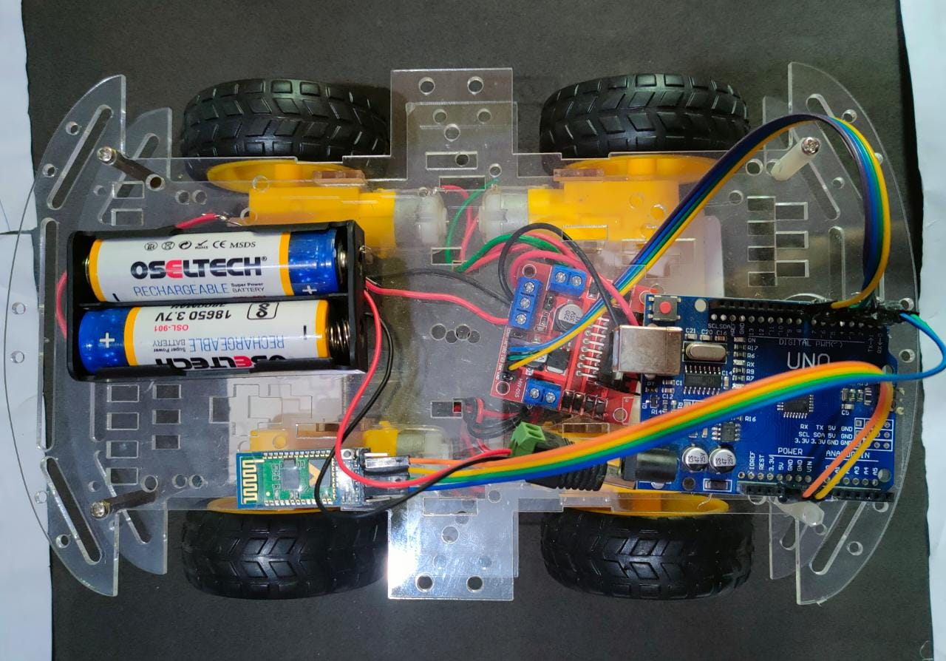
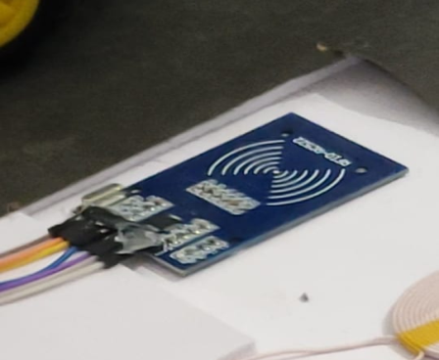
Relay module Transmitter coil Battery
Arduino Uno Bluetooth RFID reader

Slide 5
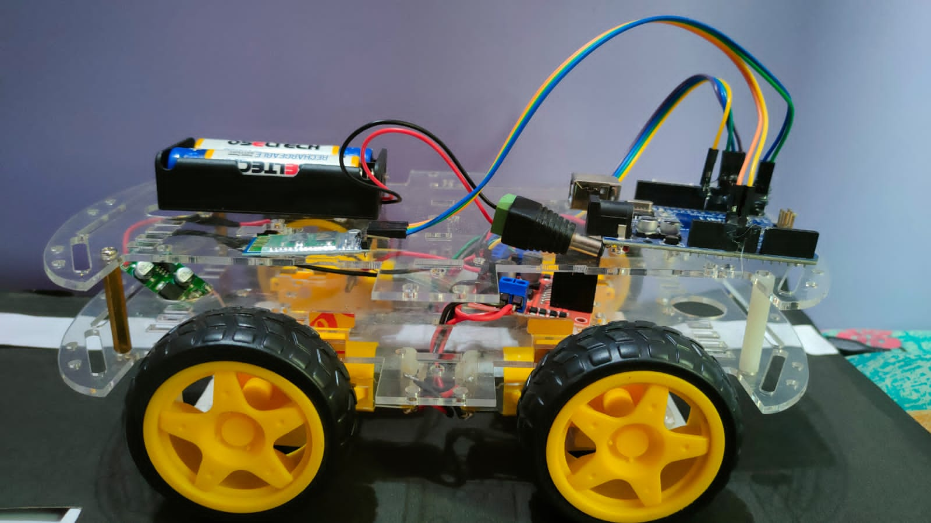
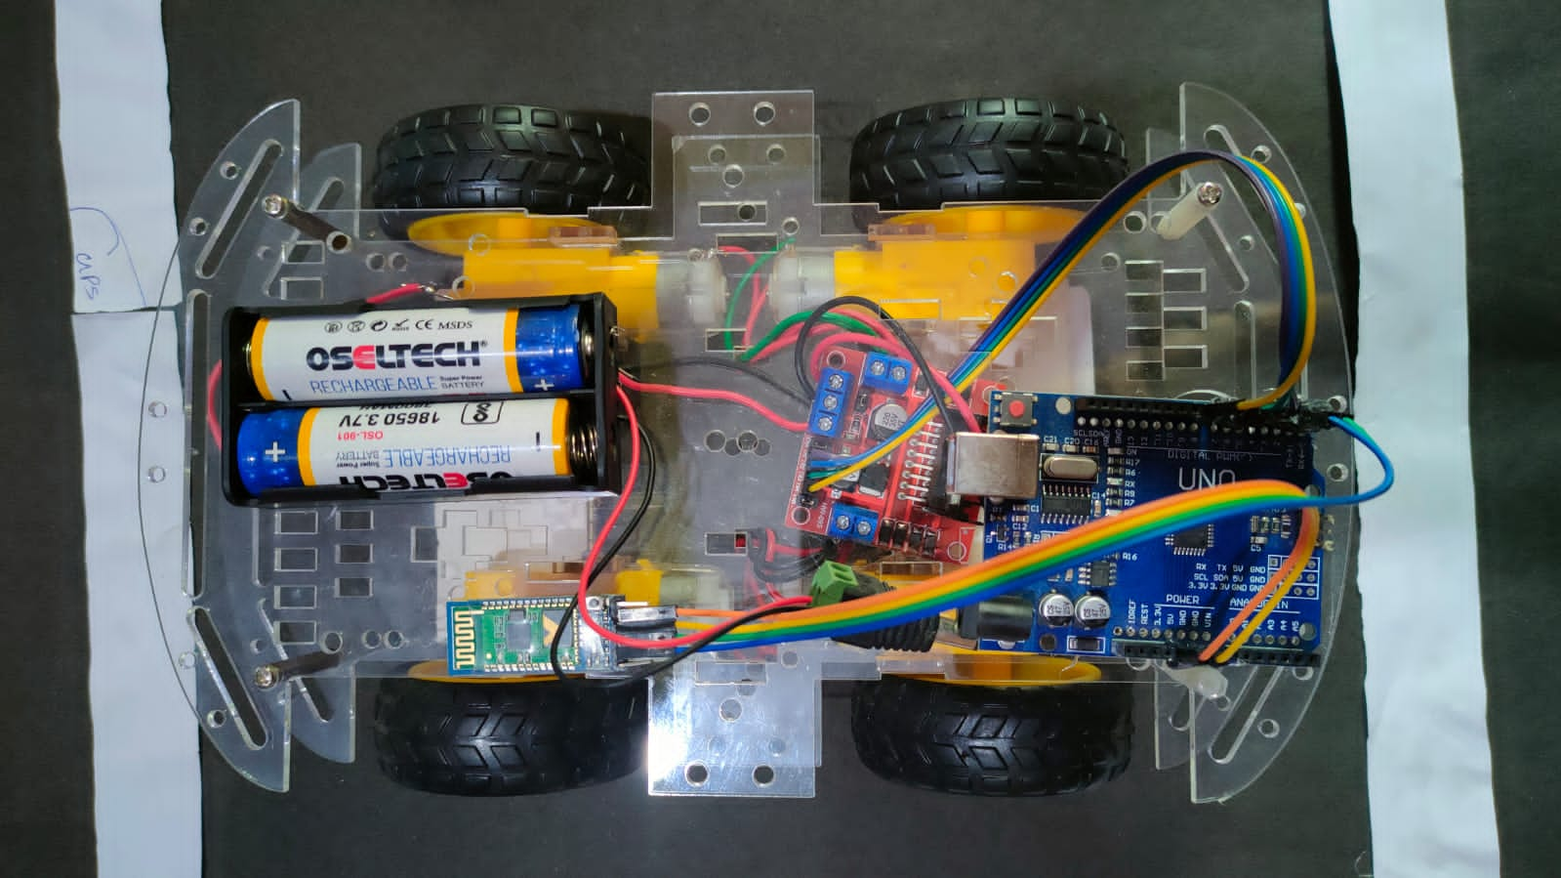

Slide 6
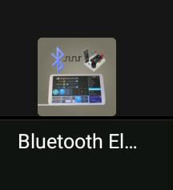
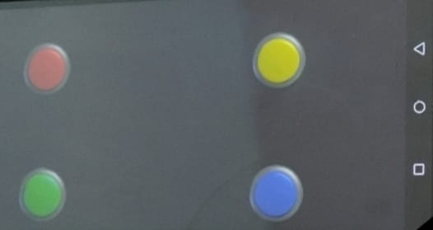
Software Implementation
Software Used: Arduino IDE
Language: Embedded (C++)
Purpose: Used to control the vehicle
Left Right
Forward Backward
Bluetooth Electronics app

Slide 7
Activities Carried out During Project
Applied for SPP Karnataka State Council for Science and Technology (KSCST) 46th series
Review paper is communicating with journal
Registered for Shakthistavar-2023 Virtual Project Exhibition organized by Department of Electrical & Electronics engineering in association with IEEE power
Registered for Srishti-2023 9th National Level Technical Project Exhibition And Competition
One data paper is in under process

Slide 8
Future Scope
Validation of model
Results and discussion

Slide 9


